Slide 1
Robot Arm Development
With Moveit motion planner and Galil controller

Slide 2
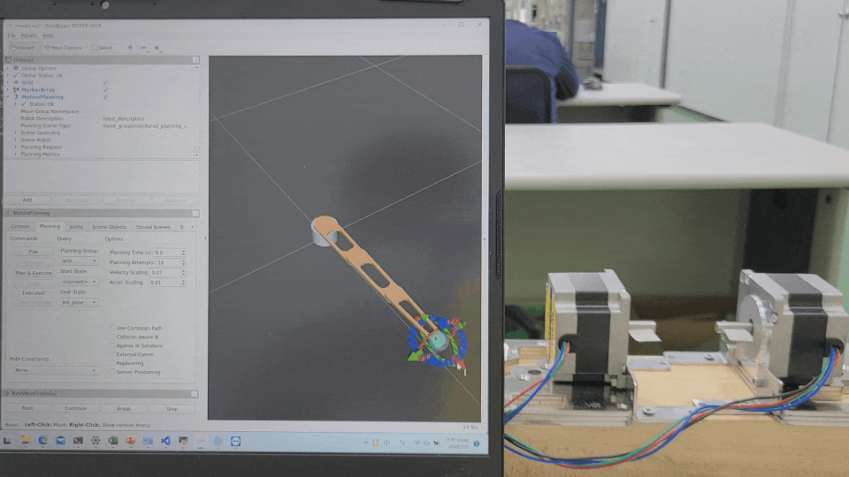
Goal

Slide 3
Overall Framework
Solidworks 3D model
SRDF
URDF
Config
User Interface
Moveit move group (Core)
Move Group
Trajectory
Trajectory
Galil commander (gclib C++)
Move Group Interface (C++)
Action
Action Client
Action
Action Server
Service
Get IK
Cmd.
GUI
(Rviz Plugin)
Plan Path
Motor feedback Subscriber
Position
Exec. Path
Moveit Function
Galil Control Card
Gclib Cmd.
Service
Change of joint state
Pulse
. . .
Collision Obj.
Attached Obj.
Joint State Subscriber
Joint State Publisher
Motor Driver
Topic
Simulation
±A ±B
Rviz Animation Simulation
(Visualization)
joint_state
Motor
Topic
Application
Moveit & ROS
Based Driver

Slide 4
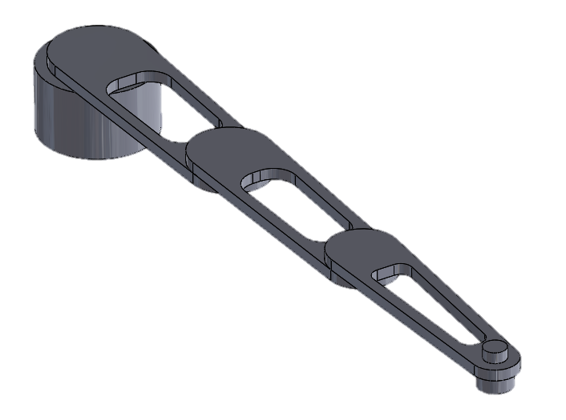
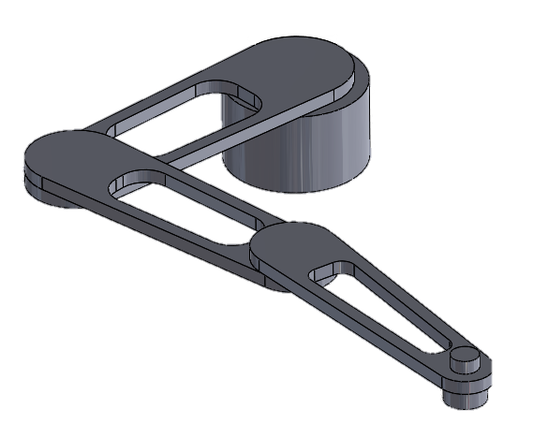
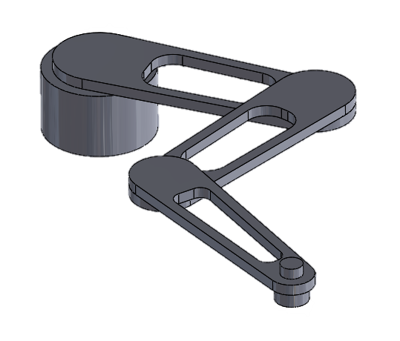
Solidworks Ass. to URDF
Install SolidWorks to URDF Exporter from github.
Define Rotation Axes, Coordinates and Limits of each joints.
Follow the sw2urdf GUI, and a ROS package with Rviz demo will be created automatically.
Solidworks to URDF tutorials

Slide 5
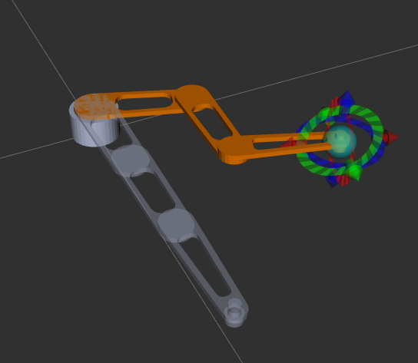
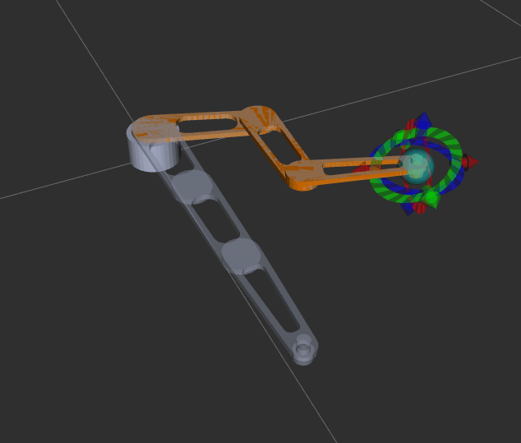
Inverse Kinematic Solver
Use Moveit setup assistant to create a Moveit package and choose KDL Kinematics Plugin as the kinematics solver.
Drag the end of the arm to the target position and click “Plan & Execute”
Mouse drag
Plan & Execute
Moveit setup assistant tutorials

Slide 6
Moveit
By default, Moveit run on a fake controller to simulate motion on a virtual robot
Substitute the fake controller for our own robot controller to control the real-world robot
Create an action server to process the trajectory message
Moveit
Action Client
Trajectory
Fake controller
Action
Moveit Function
Joint_State_Subscriber
joint_state
Topic

Slide 7
Joint Trajectory
Moveit generate a trajectory with specific positions, velocities and accelerations
Moveit send planned joint trajectory via action
Message type :
trajectory_msgs/JointTrajectoryPoint
float64[] positions
float64[] velocities
float64[] accelerations
float64[] effort
duration time_from_start
trajectory_msgs/JointTrajectoryPoint

Slide 8
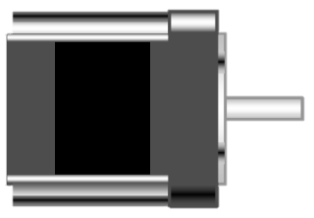
Based Driver
Hardware installation
IPC
Galil
control card
STEP+
Step
driver
A+
Ethernet
STEP-
A-
DIR+
B+
DIR-
B-
Command
Pulse
Control Current
Stepper motor
24V, GND
Power supply

Slide 9
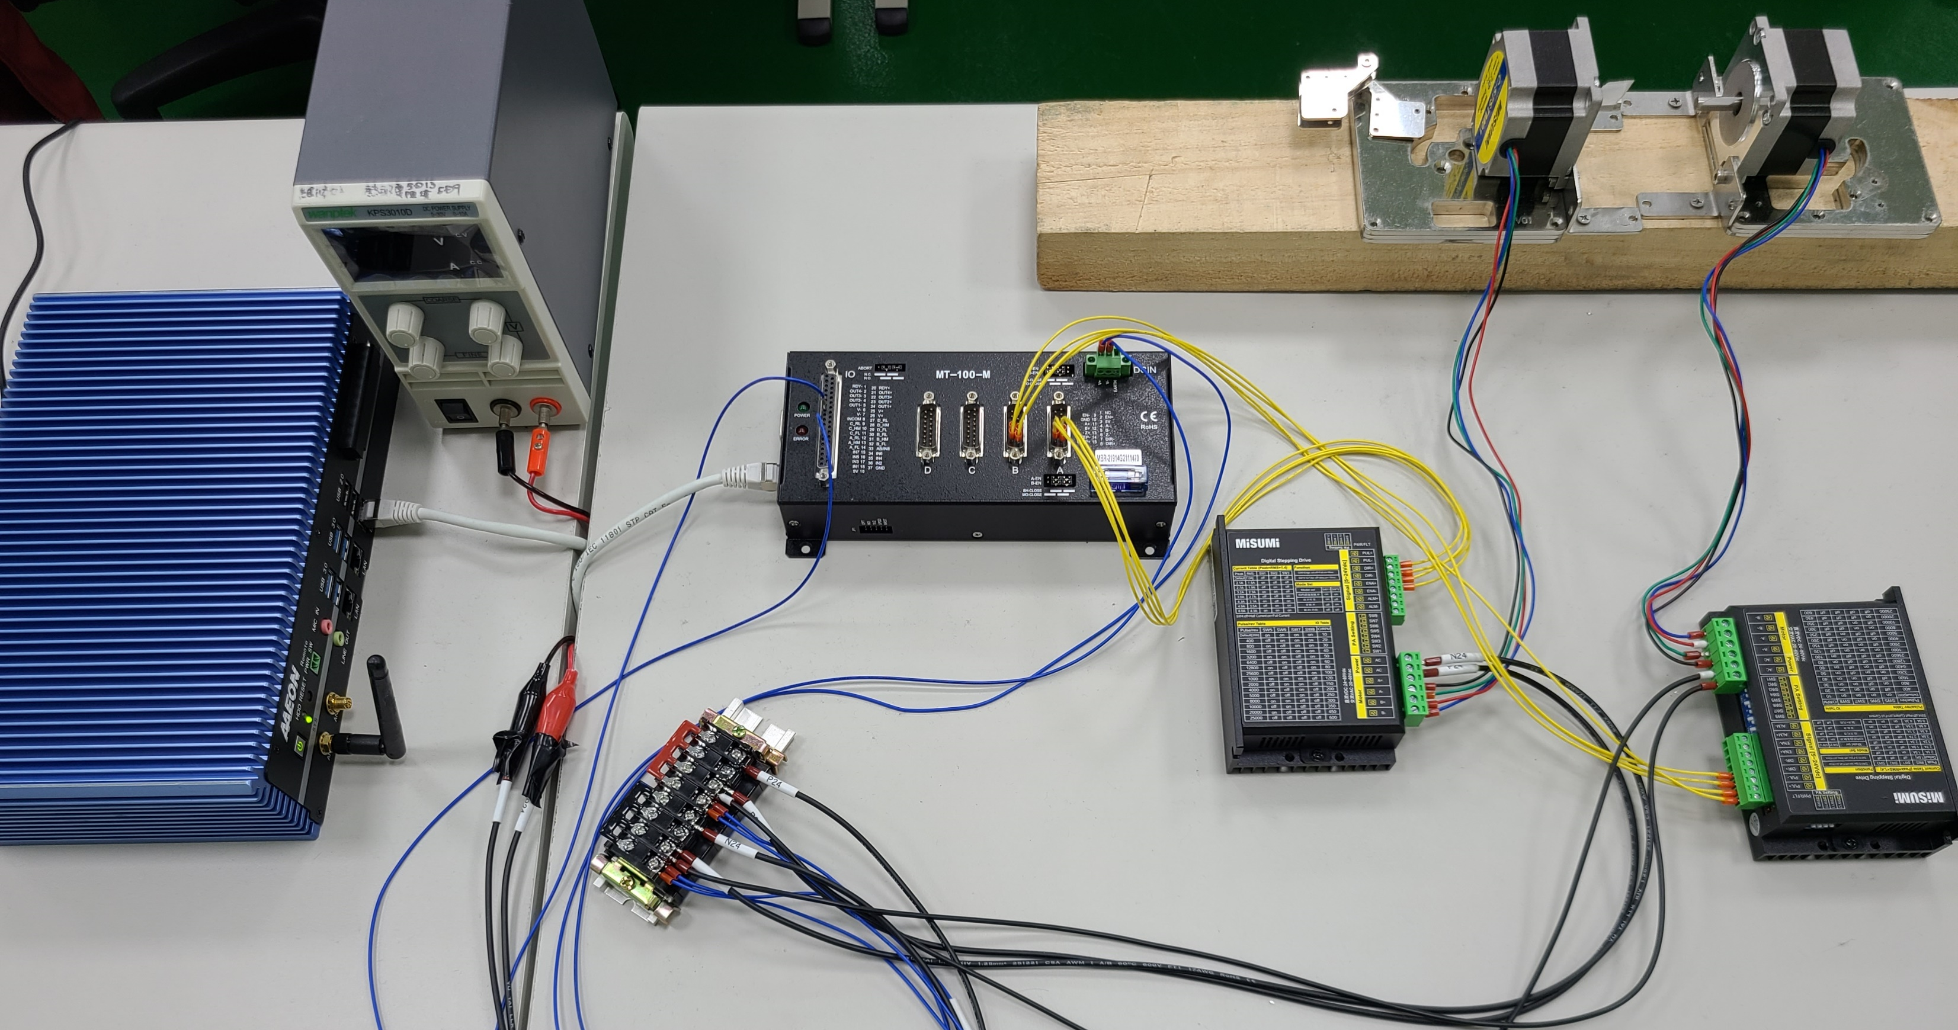
Based Driver
PSU
Step motor
IPC
Galil control card
Step driver

Slide 10
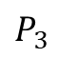
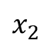
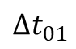
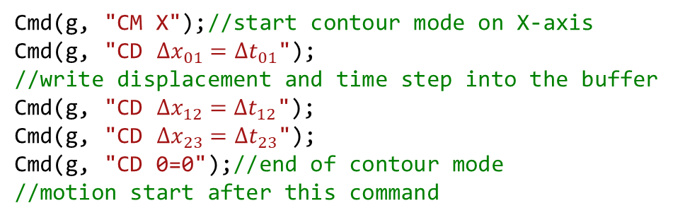
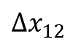
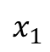
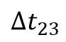
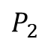
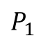
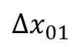
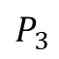
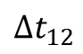
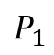
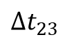
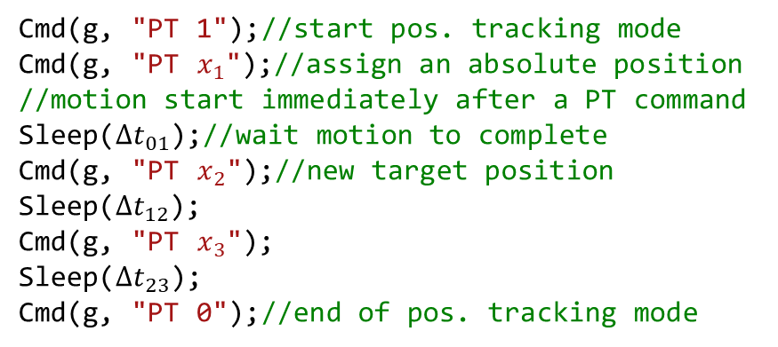
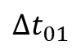
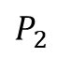
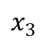
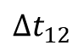
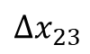
Galil Controller Solutions
Position tracking
Contour motion
x
x
$$x_{2}$$
$$P_{2}$$
$$P_{3}$$
$$P_{2}$$
$$∆x_{23}$$
$$x_{3}$$
$$∆x_{12}$$
$$P_{3}$$
$$x_{1}$$
$$P_{1}$$
$$P_{1}$$
$$∆x_{01}$$
$$∆t_{01}$$
$$∆t_{12}$$
$$∆t_{23}$$
t
$$∆t_{01}$$
$$∆t_{12}$$
$$∆t_{23}$$
t
Cmd(g, "PT 1");//start pos. tracking mode
Cmd(g, "PT $x_{1}$");//assign an absolute position
//motion start immediately after a PT command
Sleep($∆t_{01}$);//wait motion to complete
Cmd(g, "PT $x_{2}$");//new target position
Sleep($∆t_{12}$);
Cmd(g, "PT $x_{3}$");
Sleep($∆t_{23}$);
Cmd(g, "PT 0");//end of pos. tracking mode
Cmd(g, "CM X");//start contour mode on X-axis
Cmd(g, "CD $∆x_{01}=∆t_{01}$");
//write displacement and time step into the buffer
Cmd(g, "CD $∆x_{12}=∆t_{12}$");
Cmd(g, "CD $∆x_{23}=∆t_{23}$");
Cmd(g, "CD 0=0");//end of contour mode
//motion start after this command
Command Reference

Slide 11
Error Analysis
Position tracking

Slide 12
Error Analysis
Contour motion

Slide 13
Comparation
Position tracking
Pros :
Control card planning, accurate and stable
Less error
Cons :
Only 32 points can be stored into the buffer
Time interval need to be a power of 2 (2, 4, 8, …, 256)
Contour motion
Pros :
Command one point at a time, so there is no limit to the number of planning points
Can change goals during the motion
Cons :
Accumulative error may occur
The result may be different each time on the same input trajectory

Slide 14
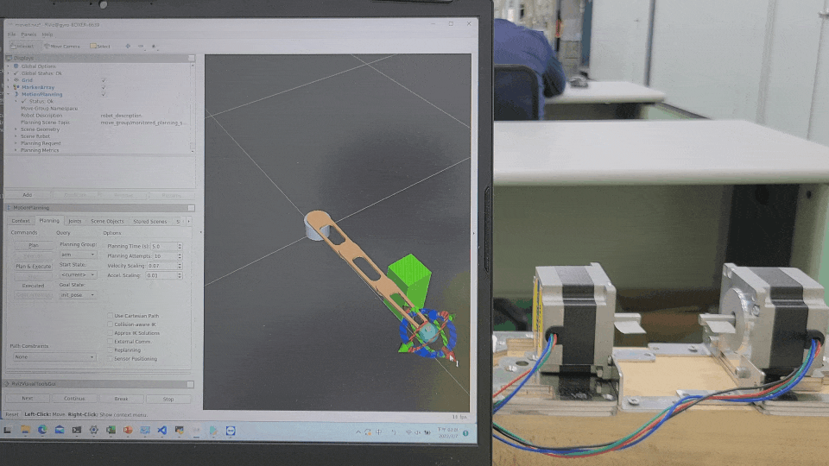
Obstacle Avoidance

Slide 15
Obstacle Avoidance
Move Group C++ Interface allows us to use API to create applications, such as collision detection, obstacle avoidance, and object attachment.
Add a collision object to the world, and then drag the end of the arm to the target position again. Moveit will generate a trajectory bypassing the obstacle.
Rviz visual tool allows us to add and erase collision objects on the GUI panel.
Move Group C++ Interface

Slide 16
Full Demo
demo (streamable.com)

Slide 17
References
sw_urdf_exporter/Tutorials - ROS Wiki
【ROS學習】Solidworks模型轉化為URDF檔案格式+三連桿機械臂示例+逆運動學
MoveIt Setup Assistant — moveit_tutorials Noetic documentation (ros-planning.github.io)
ROS中Moveit生成的轨迹如何作用与实际的机械臂(二)
trajectory_msgs/JointTrajectoryPoint
Galil Gclib command reference

